Slide 1
Advanced Behavior and Design of Steel Structure
“
Team 6 M11205310 劉映彤 M11205314 張原嘉

Slide 2
TABLE OF CONTENTS
01
Model Information
Modal Analysis
07
08
Story Drifts
02
Base Shear &
Lateral Seismic Force
09
Nonlinear
PUSHOVER Analysis
03
Load Combinations
10
Nonlinear
Time History Analysis
04
Section Selection
05
Section Inspection
Discussion & Suggestion
11
06
Design Details

Slide 3
Model Information
01
“

Slide 4
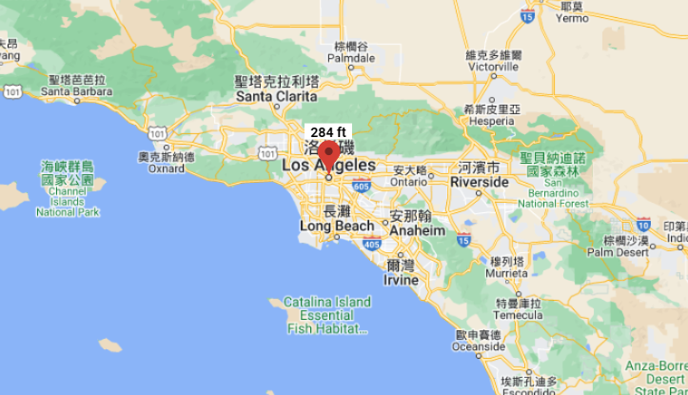
Model Information
Design Code: ASCE 7-16
III
RISK CATAGORY
SITE CLASS
D－Stiff Soil
LOCATION
Los Angeles (LA) (34.051283, -118.246637)

Slide 5
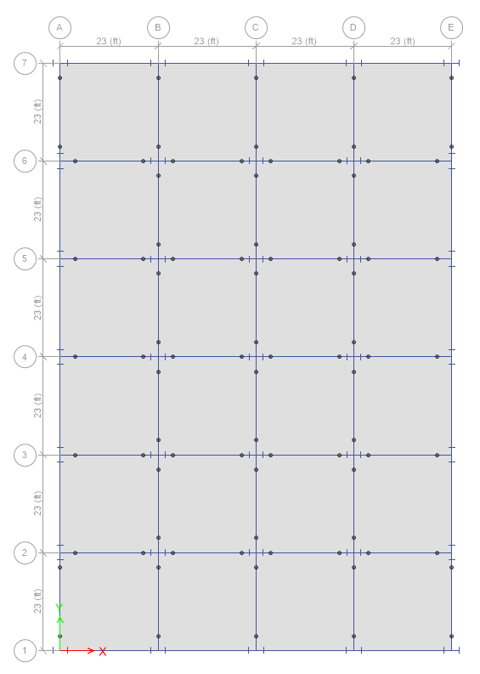
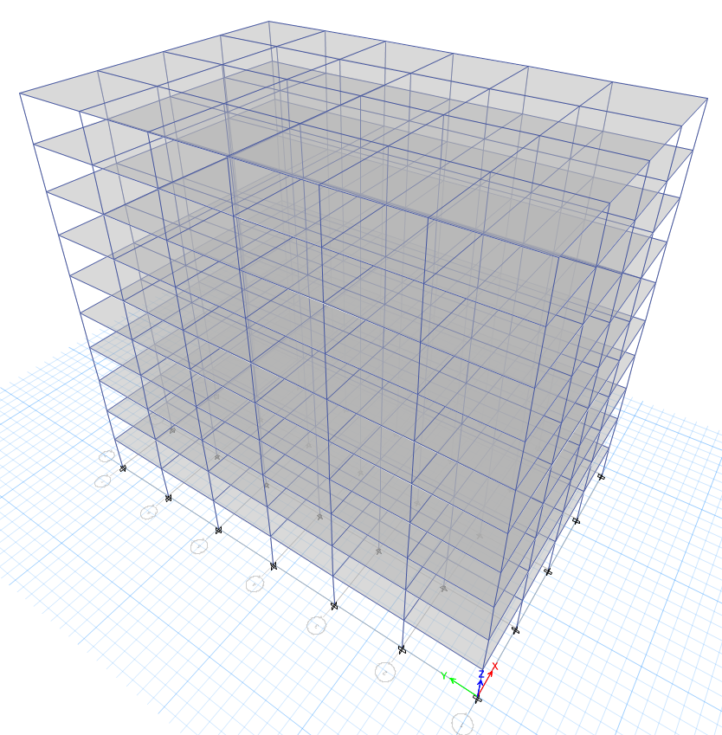
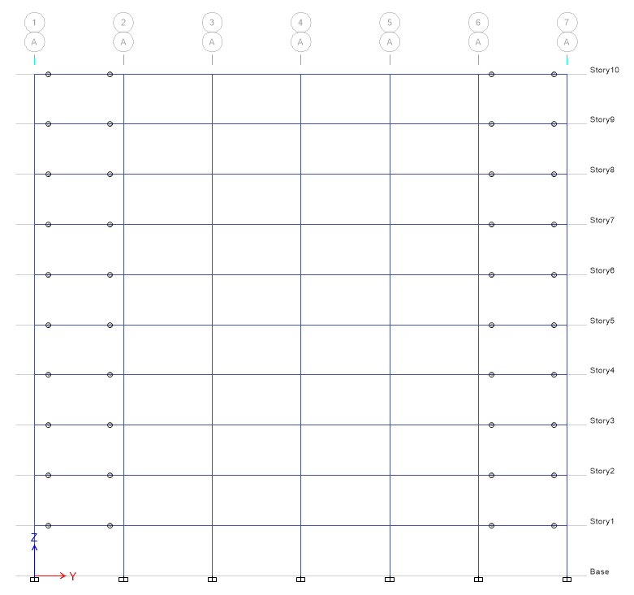
Model Information
Story Height | Span Length | No. of Stories
13 ft | 23 ft | 10
Each floor has a 4×6 span configuration.
OUTER
INTERIOR
Fixed-end moment-resisting frames (MRF).
Pin-connected gravity frames.

Slide 6
Base Shear & Lateral Seismic Force
02
“
Seismic Parameter
Base Shear
Lateral Seismic Force

Slide 7
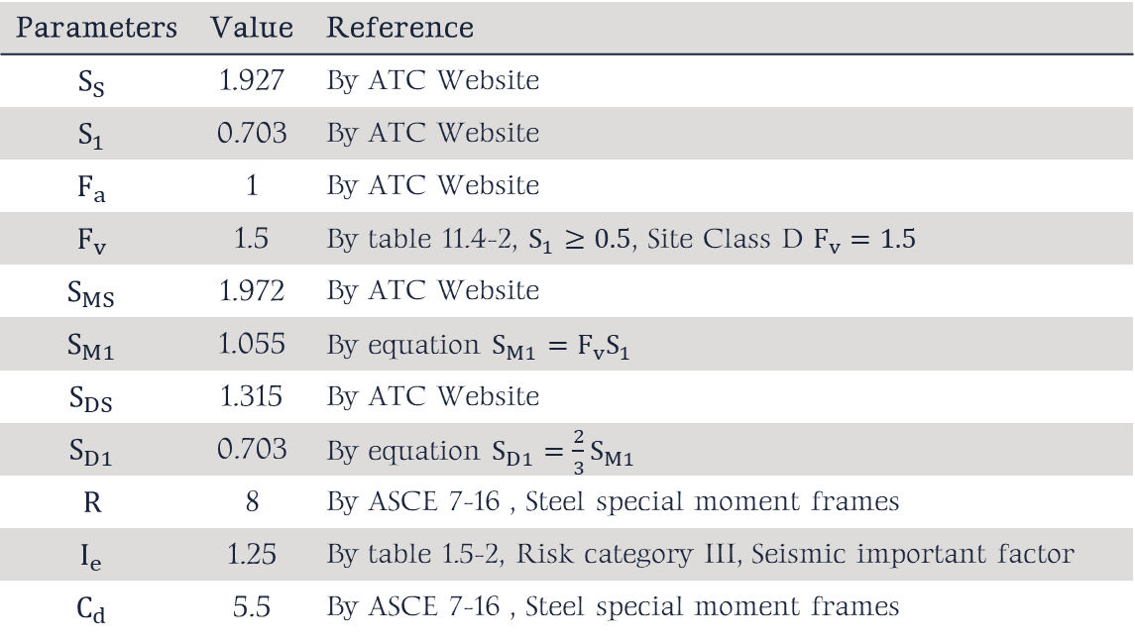
Seismic Parameters
Parameters | Value | Reference
$$S_{S}$$ | 1.927 | By ATC Website
$$S_{1}$$ | 0.703 | By ATC Website
$$F_{a}$$ | 1 | By ATC Website
$$F_{v}$$ | 1.5 | By table 11.4-2, $S_{1}≥0.5$, Site Class D $F_{v}=1.5$
$$S_{MS}$$ | 1.972 | By ATC Website
$$S_{M1}$$ | 1.055 | By equation $S_{M1}=F_{v}S_{1}$
$$S_{DS}$$ | 1.315 | By ATC Website
$$S_{D1}$$ | 0.703 | By equation $S_{D1}=\frac{2}{3}S_{M1}$
$$R$$ | 8 | By ASCE 7-16 , Steel special moment frames
$$I_{e}$$ | 1.25 | By table 1.5-2, Risk category III, Seismic important factor
$$C_{d}$$ | 5.5 | By ASCE 7-16 , Steel special moment frames

Slide 8
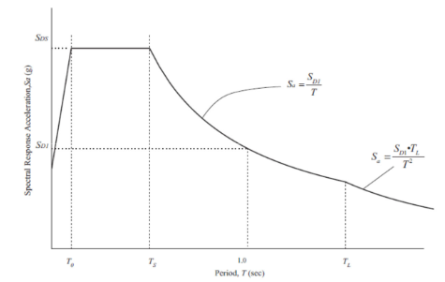
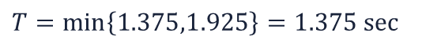
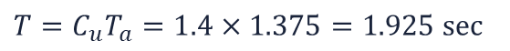

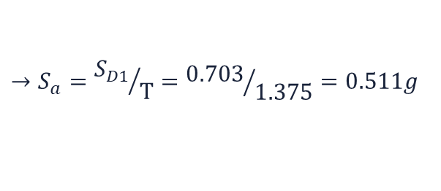
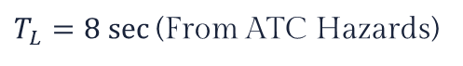

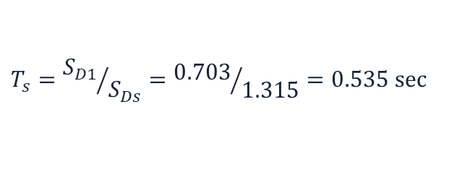
Seismic Parameters
$$T_{a}=C_{t}h_{n}^{x}=0.028×{130}^{0.8}=1.375 sec$$
$$T=C_{u}T_{a}=1.4×1.375=1.925 sec$$
$$T=min\left\{1.375,1.925\right\}=1.375 sec$$
$$T=1.375sec$$
$$T_{s}={S_{D1}}/{S_{Ds}}={0.703}/{1.315}=0.535 sec$$
$T_{L}=8 sec$(From ATC Hazards)
$$T_{s}<T<T_{L}$$
$$→S_{a}={S_{D1}}/T={0.703}/{1.375}=0.511g$$
1.375 sec
0.511g
Structural Period (T)
Spectral Response
Acceleration (S_{a})

Slide 9
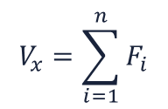
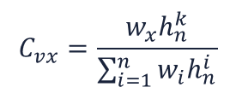
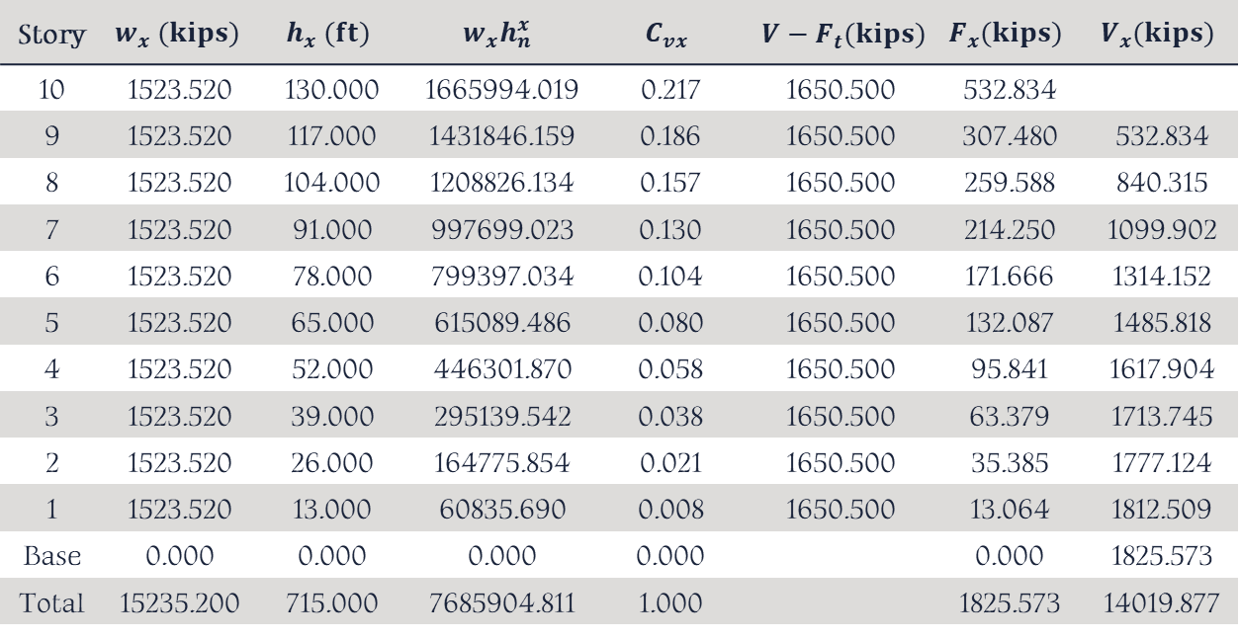
Lateral Seismic Force
$$C_{vx}=\frac{w_{x}h_{n}^{k}}{\sum_{i=1}^{n}{w_{i}h_{n}^{i}}}$$
$$V_{x}=\sum_{i=1}^{n}{F_{i}}$$
Story | $$w_{x} (kips)$$ | $$h_{x} (ft)$$ | $$w_{x}h_{n}^{x}$$ | $$C_{vx}$$ | $$V−F_{t}(kips)$$ | $$F_{x}(kips)$$ | $$V_{x}(kips)$$
10 | 1523.520 | 130.000 | 1665994.019 | 0.217 | 1650.500 | 532.834
9 | 1523.520 | 117.000 | 1431846.159 | 0.186 | 1650.500 | 307.480 | 532.834
8 | 1523.520 | 104.000 | 1208826.134 | 0.157 | 1650.500 | 259.588 | 840.315
7 | 1523.520 | 91.000 | 997699.023 | 0.130 | 1650.500 | 214.250 | 1099.902
6 | 1523.520 | 78.000 | 799397.034 | 0.104 | 1650.500 | 171.666 | 1314.152
5 | 1523.520 | 65.000 | 615089.486 | 0.080 | 1650.500 | 132.087 | 1485.818
4 | 1523.520 | 52.000 | 446301.870 | 0.058 | 1650.500 | 95.841 | 1617.904
3 | 1523.520 | 39.000 | 295139.542 | 0.038 | 1650.500 | 63.379 | 1713.745
2 | 1523.520 | 26.000 | 164775.854 | 0.021 | 1650.500 | 35.385 | 1777.124
1 | 1523.520 | 13.000 | 60835.690 | 0.008 | 1650.500 | 13.064 | 1812.509
Base | 0.000 | 0.000 | 0.000 | 0.000 |  | 0.000 | 1825.573
Total | 15235.200 | 715.000 | 7685904.811 | 1.000 |  | 1825.573 | 14019.877

Slide 10
Lateral Seismic Force
532.834 kips
307.480 kips
259.588 kips
214.250 kips
171.666 kips
132.087 kips
95.841 kips
63.379 kips
35.385 kips
13.064 kips

Slide 11
Load Combinations
03
“

Slide 12
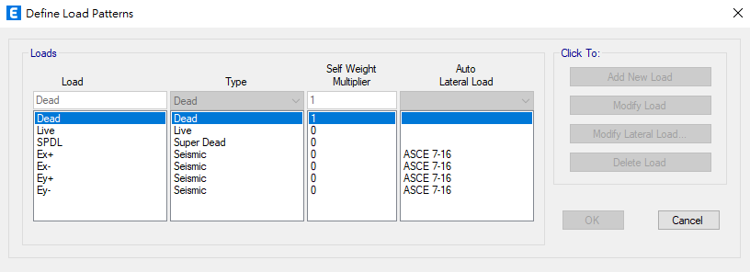
Load Combinations
DL: 120psf, LL: 100psf, SDL: 0psf

Slide 13
Load Combinations
COMBO | Load | COMBO | Load
0 | 1.4(DL)
1 | 1.4(DL + SPDL)
2 | 1.2(DL + SPDL) + 1.6LL
3 | 1.2(DL + SPDL) + 1.0LL + 1.0Ex+ | 11 | 0.9(DL + SPDL) + 1.0LL + 1.0Ex+
4 | 1.2(DL + SPDL) + 1.0LL + 1.0Ex- | 12 | 0.9(DL + SPDL) + 1.0LL + 1.0Ex-
5 | 1.2(DL + SPDL) + 1.0LL + 1.0Ey+ | 13 | 0.9(DL + SPDL) + 1.0LL + 1.0Ey+
6 | 1.2(DL + SPDL) + 1.0LL + 1.0Ey- | 14 | 0.9(DL + SPDL) + 1.0LL + 1.0Ey-
7 | 1.2(DL + SPDL) + 1.0LL - 1.0Ex+ | 15 | 0.9(DL + SPDL) + 1.0LL - 1.0Ex+
8 | 1.2(DL + SPDL) + 1.0LL - 1.0Ex- | 16 | 0.9(DL + SPDL) + 1.0LL - 1.0Ex-
9 | 1.2(DL + SPDL) + 1.0LL - 1.0Ey+ | 17 | 0.9(DL + SPDL) + 1.0LL - 1.0Ey+
10 | 1.2(DL + SPDL) + 1.0LL - 1.0Ey- | 18 | 0.9(DL + SPDL) + 1.0LL - 1.0Ey-

Slide 14
Section Selection
04
“

Slide 15
Section Selection
Fixed-end moment-resisting frames (MRF).
Story | Beam (in.) | Stress Ratio | Column (in.) | Ext. Col. | Int. Col.
 |  |  |  | Stress Ratio
10 | BH 36x18x1.3x1.75 | 0.056~0.090 | BH 36x30x1.5x2.4 | 0.049~0.057 | 0.075~0.085
9 |  | 0.100~0.135 |  | 0.062~0.067 | 0.090~0.099
8 |  | 0.154~0.183 |  | 0.078~0.088 | 0.130~0.136
7 |  | 0.204~0.231 |  | 0.097~0.111 | 0.165~0.170
6 |  | 0.248~0.272 |  | 0.123~0.140 | 0.195~0.197
5 |  | 0.283~0.304 | BH 36x32x1.5x2.4 | 0.208~0.233 | 0.204~0.205
4 |  | 0.307~0.326 |  | 0.265~0.295 | 0.222~0.224
3 |  | 0.314~0.337 |  | 0.325~0.359 | 0.239~0.244
2 |  | 0.299~0.326 |  | 0.383~0.422 | 0.259~0.268
1 |  | 0.236~0.262 |  | 0.431~0.475 | 0.298~0.303

Slide 16
Section Selection
Pin-connected gravity frames.
Story | Beam | Stress Ratio | Column | Stress Ratio
10 | W 12x136 | 0.131 ~ 0.204 | W 12x336 | 0.046 ~ 0.061
9 |  | 0.129 ~ 0.202 |  | 0.075 ~ 0.084
8 |  | 0.129 ~ 0.202 |  | 0.107 ~ 0.116
7 |  | 0.129 ~ 0.201 |  | 0.225 ~ 0.232
6 |  | 0.129 ~ 0.200 |  | 0.279 ~ 0.286
5 |  | 0.128 ~ 0.200 | W 14x370 | 0.305 ~ 0.312
4 |  | 0.128 ~ 0.200 |  | 0.355 ~ 0.361
3 |  | 0.128 ~ 0.199 |  | 0.406 ~ 0.412
2 |  | 0.128 ~ 0.199 |  | 0.462 ~ 0.472
1 |  | 0.128 ~ 0.198 |  | 0.506 ~ 0.522

Slide 17
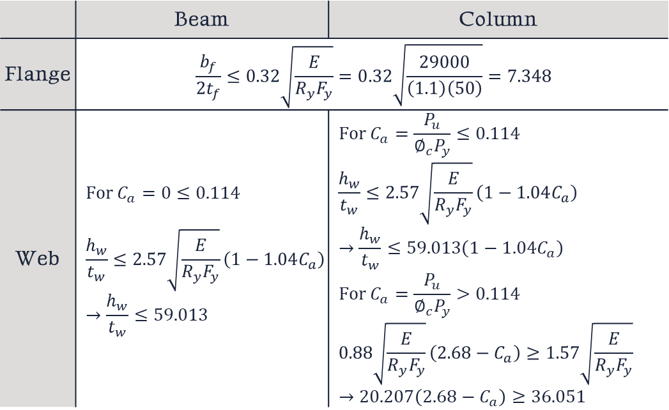
Width-Thickness Ratio Inspection
According to AISC 341-16 Table D1.1 highly ductile members
 | Beam | Column
Flange | $$\frac{b_{f}}{2t_{f}}≤0.32\sqrt{\frac{E}{R_{y}F_{y}}}=0.32\sqrt{\frac{29000}{\left(1.1\right)\left(50\right)}}=7.348$$
Web | $$For C_{a}=0≤0.114$$ $$\frac{h_{w}}{t_{w}}≤2.57\sqrt{\frac{E}{R_{y}F_{y}}}\left(1−1.04C_{a}\right)$$ $$→\frac{h_{w}}{t_{w}}≤59.013$$ | $$For C_{a}=\frac{P_{u}}{∅_{c}P_{y}}≤0.114$$ $$\frac{h_{w}}{t_{w}}≤2.57\sqrt{\frac{E}{R_{y}F_{y}}}\left(1−1.04C_{a}\right)$$ $$→\frac{h_{w}}{t_{w}}≤59.013\left(1−1.04C_{a}\right)$$ $$For C_{a}=\frac{P_{u}}{∅_{c}P_{y}}>0.114$$ $$0.88\sqrt{\frac{E}{R_{y}F_{y}}}\left(2.68−C_{a}\right)≥1.57\sqrt{\frac{E}{R_{y}F_{y}}}$$ $$→20.207\left(2.68−C_{a}\right)≥36.051$$

Slide 18
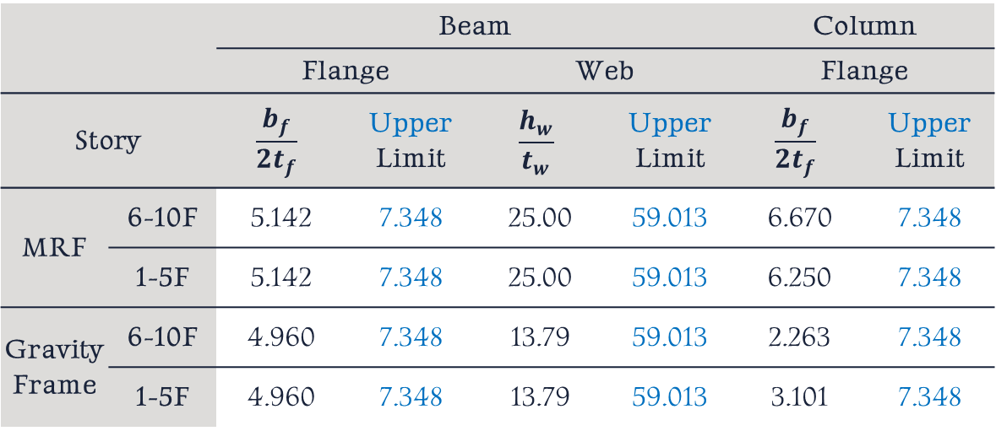
Width-Thickness Ratio Inspection
Width-Thickness Ratio Inspection
 |  | Beam |  |  |  | Column
 |  | Flange |  | Web |  | Flange
Story |  | $$\frac{b_{f}}{2t_{f}}$$ | Upper Limit | $$\frac{h_{w}}{t_{w}}$$ | Upper Limit | $$\frac{b_{f}}{2t_{f}}$$ | Upper Limit
MRF | 6-10F | 5.142 | 7.348 | 25.00 | 59.013 | 6.670 | 7.348
 | 1-5F | 5.142 | 7.348 | 25.00 | 59.013 | 6.250 | 7.348
Gravity Frame | 6-10F | 4.960 | 7.348 | 13.79 | 59.013 | 2.263 | 7.348
 | 1-5F | 4.960 | 7.348 | 13.79 | 59.013 | 3.101 | 7.348
PASS!
PASS!
PASS!

Slide 19
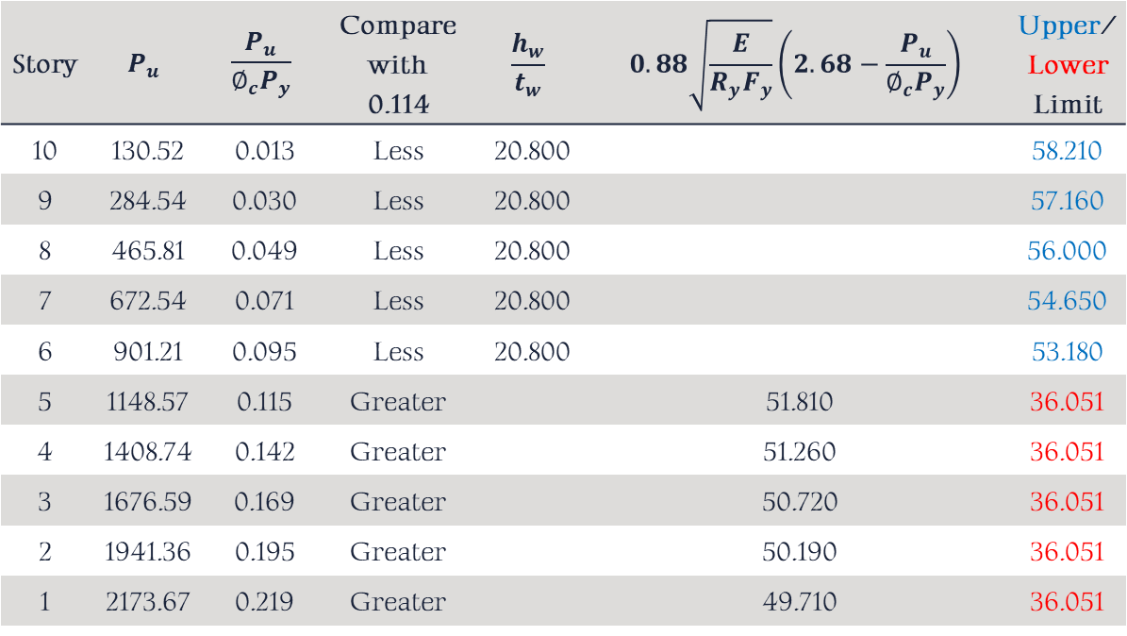
Column web inspection of MRF
Width-Thickness Ratio Inspection
Story | $$P_{u}$$ | $$\frac{P_{u}}{∅_{c}P_{y}}$$ | Compare with 0.114 | $$\frac{h_{w}}{t_{w}}$$ | $$0.88\sqrt{\frac{E}{R_{y}F_{y}}}\left(2.68−\frac{P_{u}}{∅_{c}P_{y}}\right)$$ | Upper/ Lower Limit
10 | 130.52 | 0.013 | Less | 20.800 |  | 58.210
9 | 284.54 | 0.030 | Less | 20.800 |  | 57.160
8 | 465.81 | 0.049 | Less | 20.800 |  | 56.000
7 | 672.54 | 0.071 | Less | 20.800 |  | 54.650
6 | 901.21 | 0.095 | Less | 20.800 |  | 53.180
5 | 1148.57 | 0.115 | Greater |  | 51.810 | 36.051
4 | 1408.74 | 0.142 | Greater |  | 51.260 | 36.051
3 | 1676.59 | 0.169 | Greater |  | 50.720 | 36.051
2 | 1941.36 | 0.195 | Greater |  | 50.190 | 36.051
1 | 2173.67 | 0.219 | Greater |  | 49.710 | 36.051
PASS!
PASS!
PASS!
PASS!
PASS!
PASS!
PASS!
PASS!
PASS!
PASS!

Slide 20
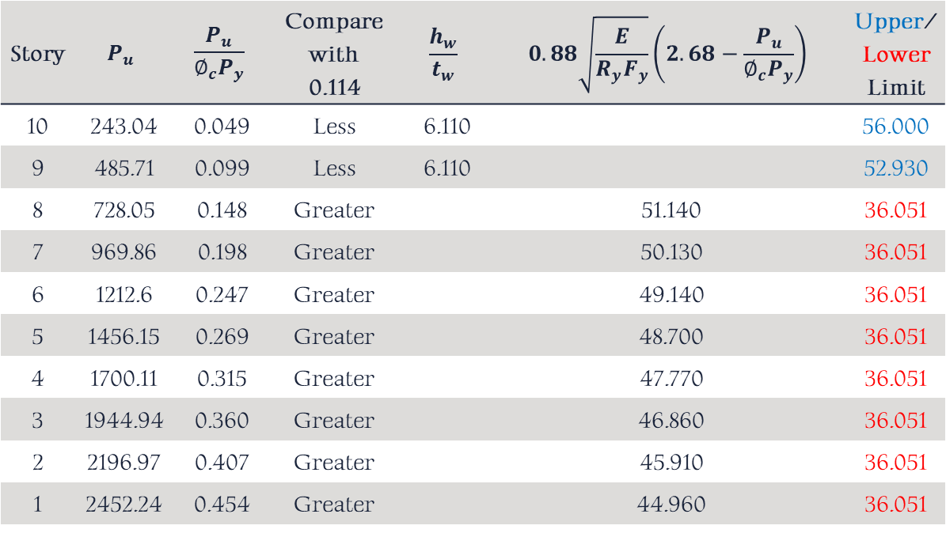
Column web inspection of gravity frames
Width-Thickness Ratio Inspection
Story | $$P_{u}$$ | $$\frac{P_{u}}{∅_{c}P_{y}}$$ | Compare with 0.114 | $$\frac{h_{w}}{t_{w}}$$ | $$0.88\sqrt{\frac{E}{R_{y}F_{y}}}\left(2.68−\frac{P_{u}}{∅_{c}P_{y}}\right)$$ | Upper/ Lower Limit
10 | 243.04 | 0.049 | Less | 6.110 |  | 56.000
9 | 485.71 | 0.099 | Less | 6.110 |  | 52.930
8 | 728.05 | 0.148 | Greater |  | 51.140 | 36.051
7 | 969.86 | 0.198 | Greater |  | 50.130 | 36.051
6 | 1212.6 | 0.247 | Greater |  | 49.140 | 36.051
5 | 1456.15 | 0.269 | Greater |  | 48.700 | 36.051
4 | 1700.11 | 0.315 | Greater |  | 47.770 | 36.051
3 | 1944.94 | 0.360 | Greater |  | 46.860 | 36.051
2 | 2196.97 | 0.407 | Greater |  | 45.910 | 36.051
1 | 2452.24 | 0.454 | Greater |  | 44.960 | 36.051
PASS!
PASS!
PASS!
PASS!
PASS!
PASS!
PASS!
PASS!
PASS!
PASS!

Slide 21
Section Inspection
05
“
Strong Column and Weak Beam

Slide 22
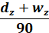
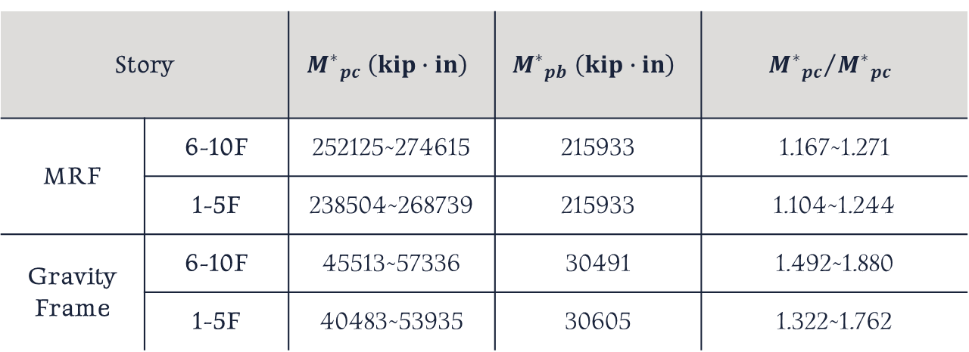
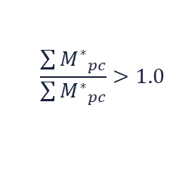
Strong Column/Weak Beam Inspection
$$\frac{\sum{{M^{∗}}_{pc}}}{\sum{{M^{∗}}_{pc}}}>1.0$$
Story |  | $${M^{∗}}_{pc} \left(kip∙in\right)$$ | $${M^{∗}}_{pb} \left(kip∙in\right)$$ | $${{M^{∗}}_{pc}}/{{M^{∗}}_{pc}}$$
MRF | 6-10F | 252125~274615 | 215933 | 1.167~1.271
 | 1-5F | 238504~268739 | 215933 | 1.104~1.244
Gravity Frame | 6-10F | 45513~57336 | 30491 | 1.492~1.880
 | 1-5F | 40483~53935 | 30605 | 1.322~1.762
PASS!
PASS!
PASS!
PASS!

Slide 23
Design Details
06
“
Width-Thickness Ratio Inspection
Doubler Plate
Continuity Plate
Connection Size

Slide 24
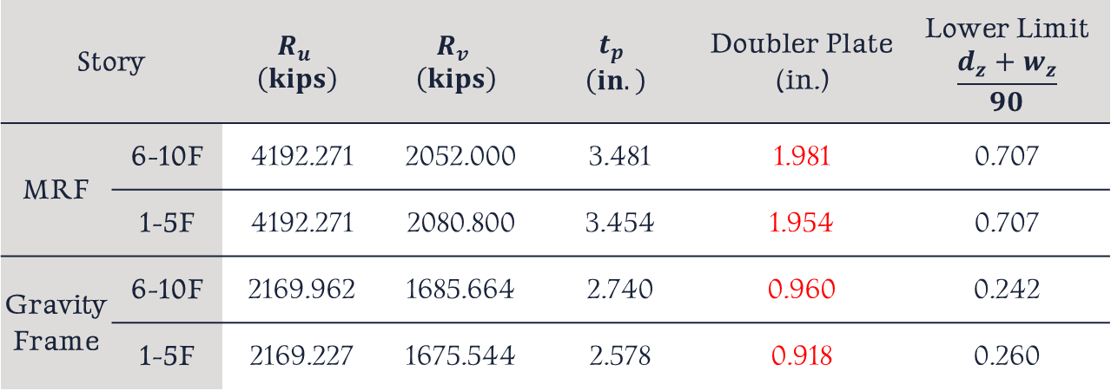
Doubler Plate
Story |  | $$R_{u}$$ $$\left(kips\right)$$ | $$R_{v}$$ $$\left(kips\right)$$ | $$t_{p}$$ $$\left(in.\right)$$ | Doubler Plate (in.) | Lower Limit $$\frac{d_{z}+w_{z}}{90}$$
MRF | 6-10F | 4192.271 | 2052.000 | 3.481 | 1.981 | 0.707
 | 1-5F | 4192.271 | 2080.800 | 3.454 | 1.954 | 0.707
Gravity Frame | 6-10F | 2169.962 | 1685.664 | 2.740 | 0.960 | 0.242
 | 1-5F | 2169.227 | 1675.544 | 2.578 | 0.918 | 0.260
PASS!
PASS!
PASS!
PASS!

Slide 25
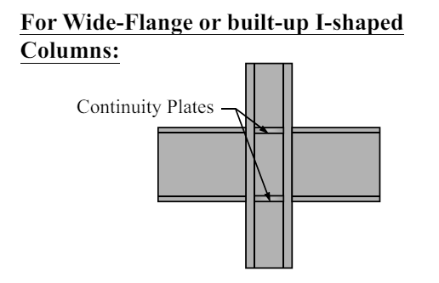

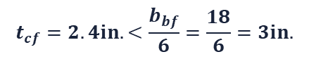
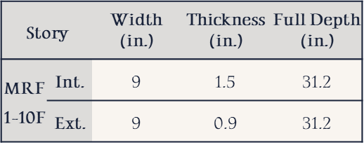
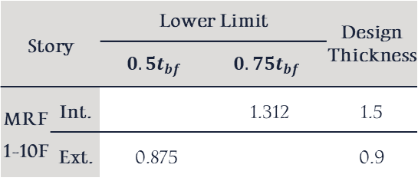
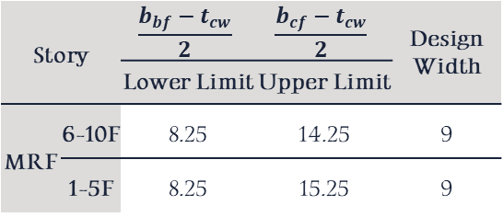
Continuity Plate
$$t_{cf}=2.4in.<\frac{b_{bf}}{6}=\frac{18}{6}=3in.$$
Story |  | $$\frac{b_{bf}−t_{cw}}{2}$$ | $$\frac{b_{cf}−t_{cw}}{2}$$ | Design Width
 |  | Lower Limit | Upper Limit
MRF | 6-10F | 8.25 | 14.25 | 9
 | 1-5F | 8.25 | 15.25 | 9
Story |  | Lower Limit |  | Design Thickness
 |  | $$0.5t_{bf}$$ | $$0.75t_{bf}$$
MRF 1-10F | Int. |  | 1.312 | 1.5
 | Ext. | 0.875 |  | 0.9
PASS!
PASS!
PASS!
PASS!
Design Configuration:
Story |  | Width (in.) | $\text{Thickness}$ (in.) | Full Depth (in.)
MRF 1-10F | Int. | 9 | 1.5 | 31.2
 | Ext. | 9 | 0.9 | 31.2
Two plates
Two plates

Slide 26

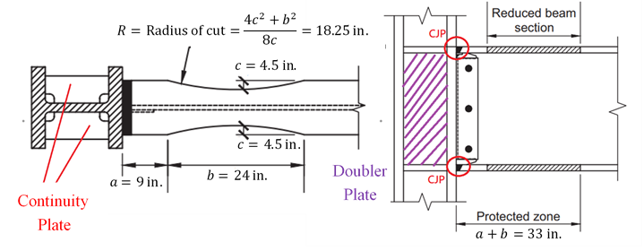

Connection Size
Reduced Beam Section, RBS
Limitations
Selection: a = 9 in., b = 24 in., c = 4.5 in.
Beam:
1. Beam Depth = 36in. ≦ 36in.
2. Beam flange thickness = 1.75 in. ≦ 1.75in.
3. The clear span-to-depth ratio = 7.661 in. ≧ 7in.
PASS!
RBS Size:
0.5b_{bf} =9 ≦ a ≦ 0.75b_{bf} =13.5
0.65d =23.5 ≦ b ≦ 0.85d =30.6
0.1b_{bf} =1.8 ≦ c ≦ 0.25b_{bf} =4.5
PASS!
PASS!
PASS!
PASS!
Column:
1. Column Depth = 36in. ≦ 36in.
PASS!
PASS!
Width-to-thickness ratios:
Satisfy the requirements of AISC code
PASS!

Slide 27
Modal Analysis
07
“
Structural Period
Structural Mode

Slide 28
Structural Period
$$T=1.187 sec<C_{u}T_{a}=1.4×1.375=1.925 sec$$
PASS!
Case | Mode | Period (sec) | Frequency (cyc/sec) | CircFreq (rad/sec) | Eigenvalue (rad²/sec²)
Modal | 1 | 1.187 | 0.842 | 5.293 | 28.079
Modal | 2 | 1.185 | 0.844 | 5.304 | 28.137
Modal | 3 | 0.755 | 1.324 | 8.320 | 69.213

Slide 29
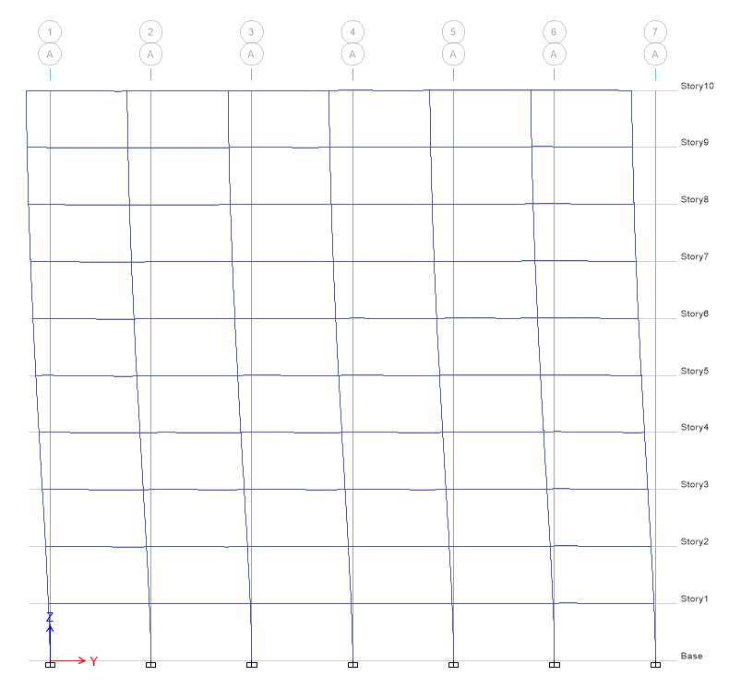
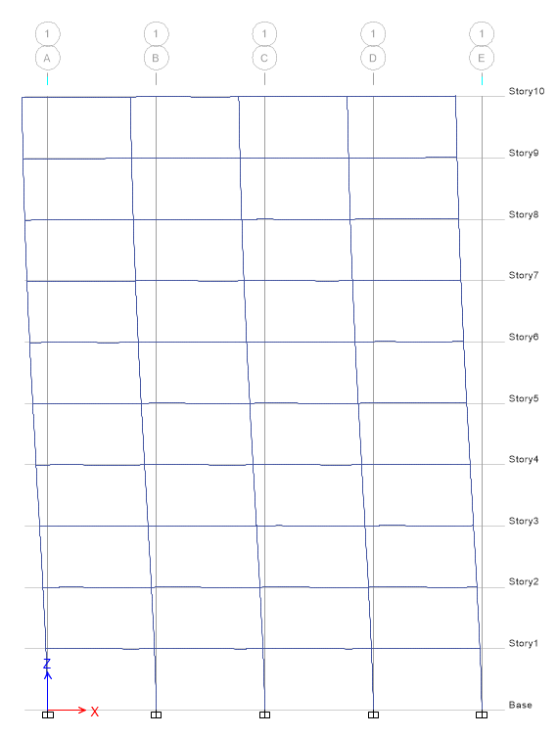
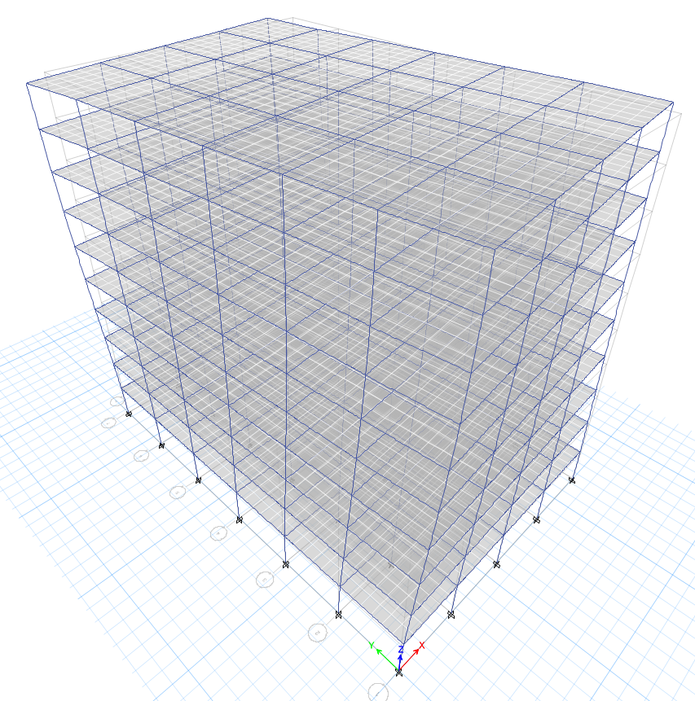
Structural Mode
Mode 1
Mode 2
Mode 3
Y Direction
X Direction
Torsion

Slide 30
Story Drifts
08
“

Slide 31
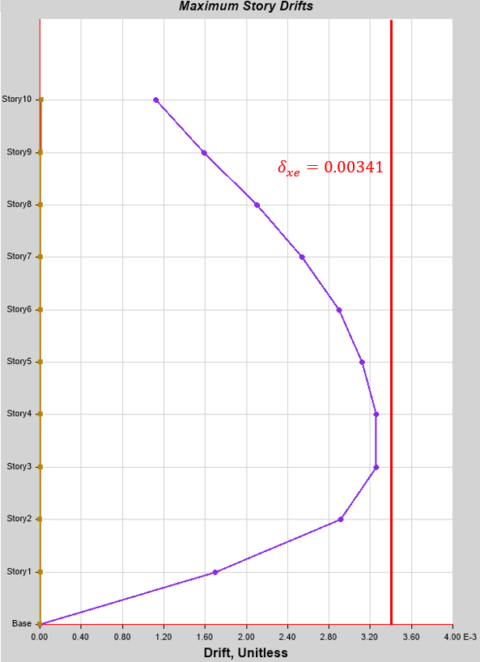
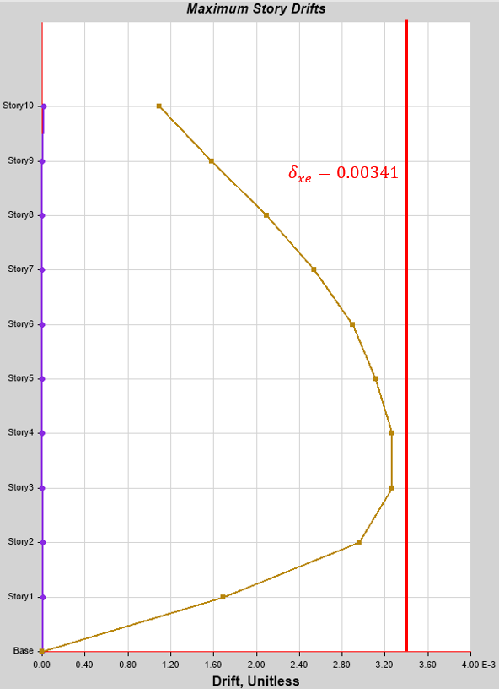
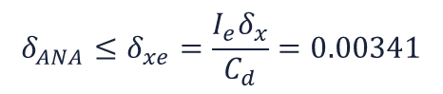
Story Drifts
$$δ_{ANA}≤δ_{xe}=\frac{I_{e}δ_{x}}{C_{d}}=0.00341$$
The maximum inter-story drifts both occur on the fourth floor.
X Direction
Y Direction
PASS!
PASS!

Slide 32
Nonlinear PUSHOVER Analysis
09
“
PUSHOVER Curve
Story Drifts
Plastic Hinge Distribution

Slide 33
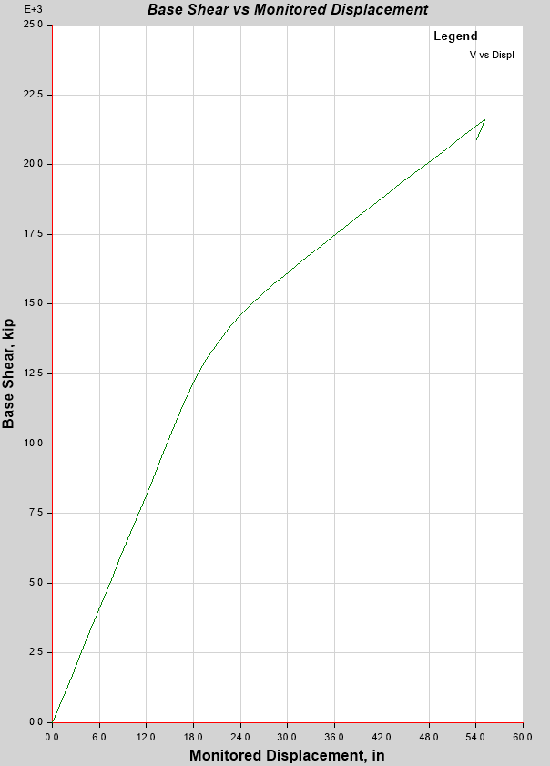
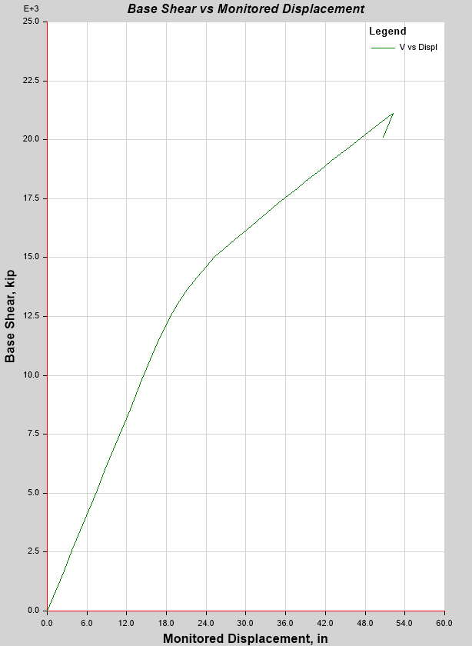
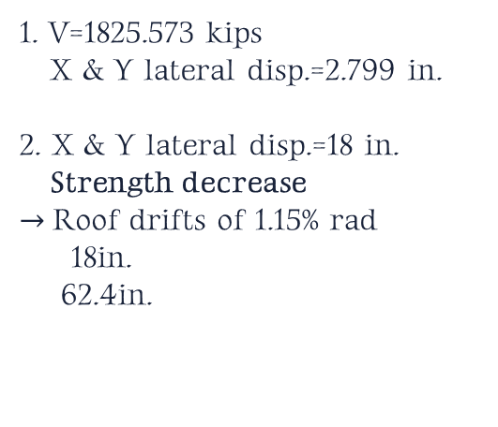
PUSHOVER Curve
Set the plastic hinges at the relative positions of the 0.05 and 0.95 members of the beam and column.
1. V=1825.573 kips
X & Y lateral disp.=2.799 in.
2. X & Y lateral disp.=18 in.
Strength decrease
$→$Roof drifts of 1.15% rad
18in.
62.4in.
Lateral Disp.=18 in.
Lateral Disp.=18 in.
×4% = 1.15%
V=1825.573 kips
X-Dir
Y-Dir

Slide 34
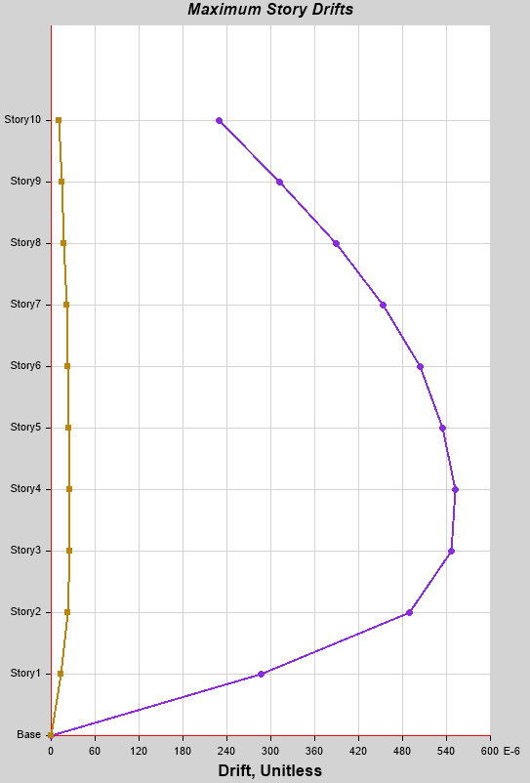
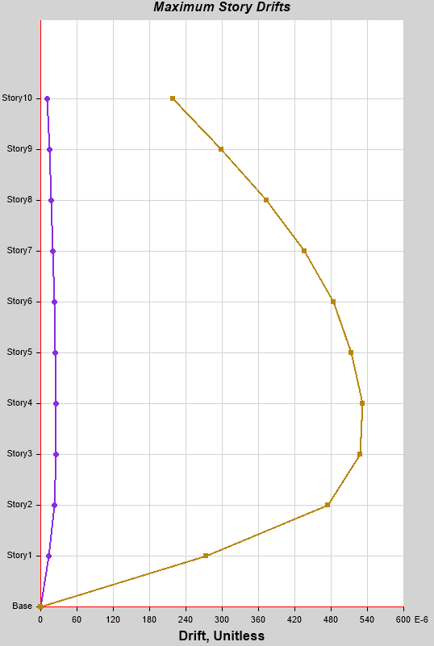
Story Drifts
The maximum inter-story drifts both occur on the fourth floor.
(Roof drifts of 2% rad)
X Direction
Y Direction
MAX
MAX

Slide 35
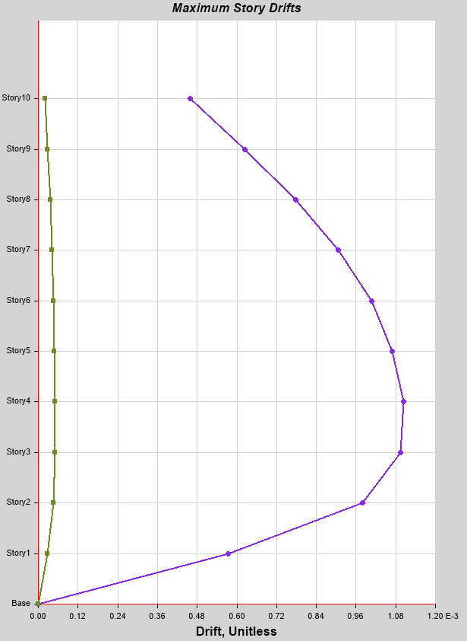
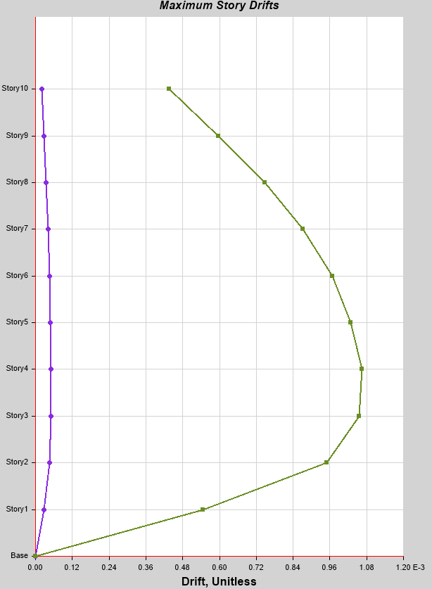
Story Drifts
The maximum inter-story drifts both occur on the fourth floor.
(Roof drifts of 4% rad)
X Direction
Y Direction
MAX
MAX

Slide 36
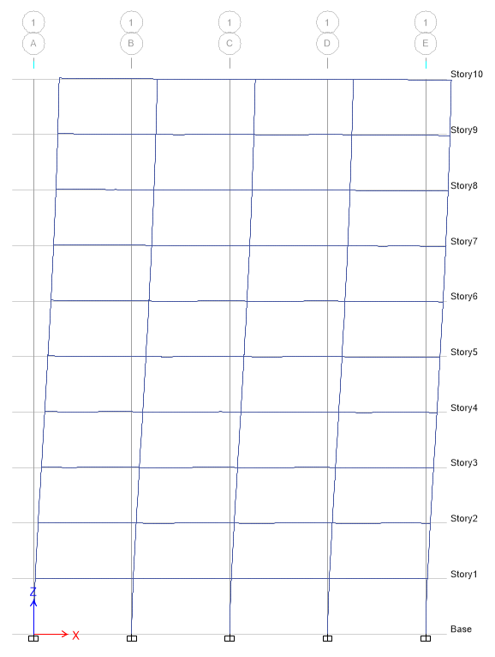
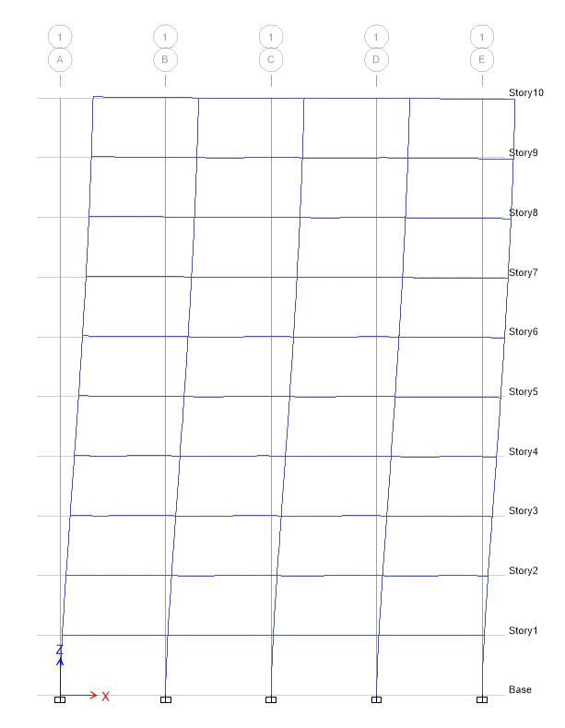
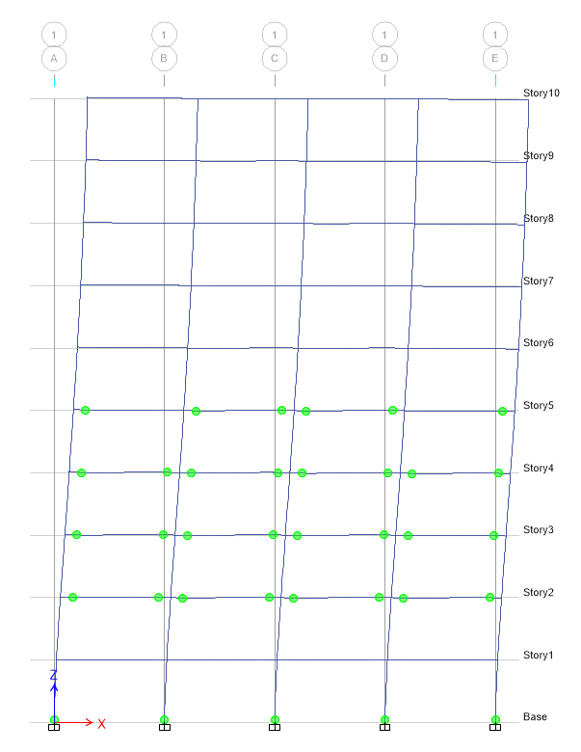
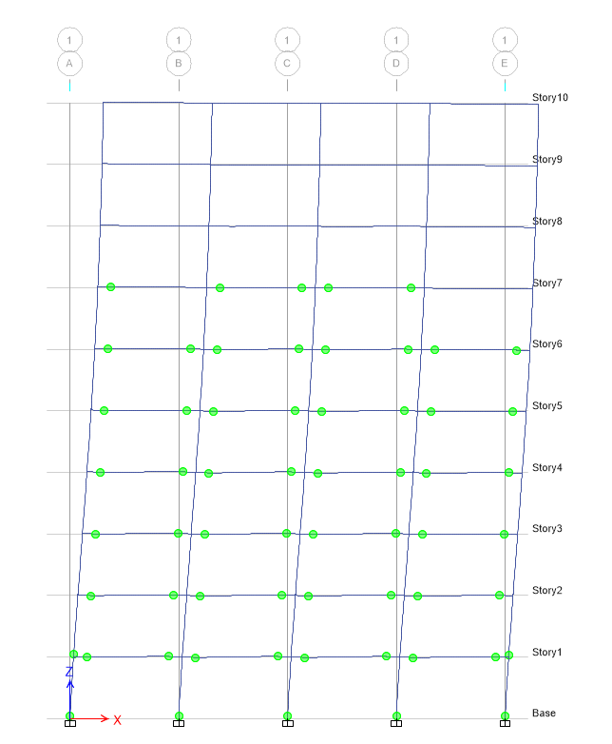
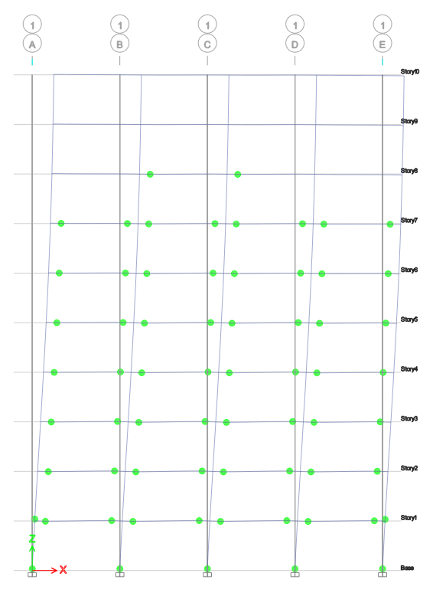
Plastic Hinge Distribution (X-Dir)
Plastic hinge occurs on 1st to 6th floors
→ Strength decrease before reaching 1.5%
10th floor
no plastic hinge
No plastic hinge
0.5%
1%
1.5%
2%
4%

Slide 37
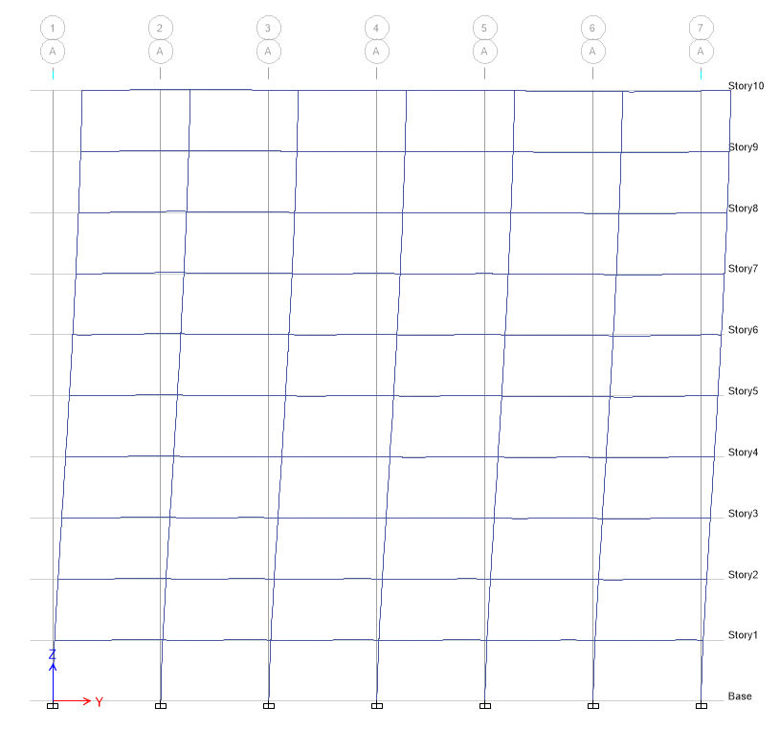
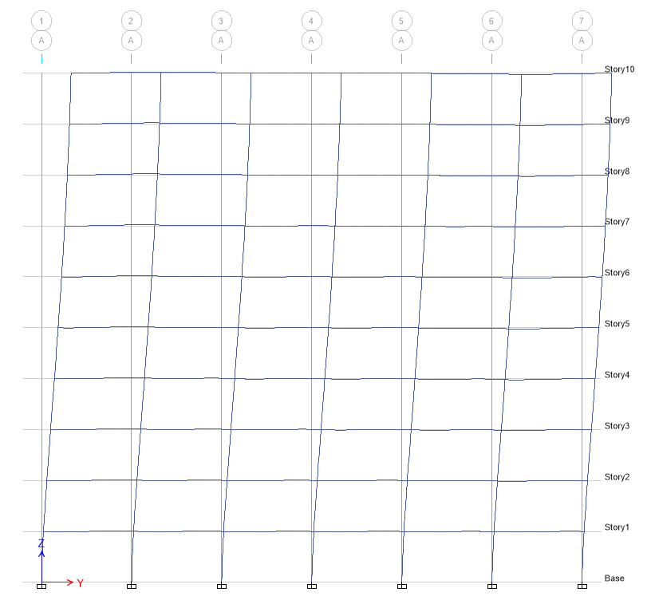
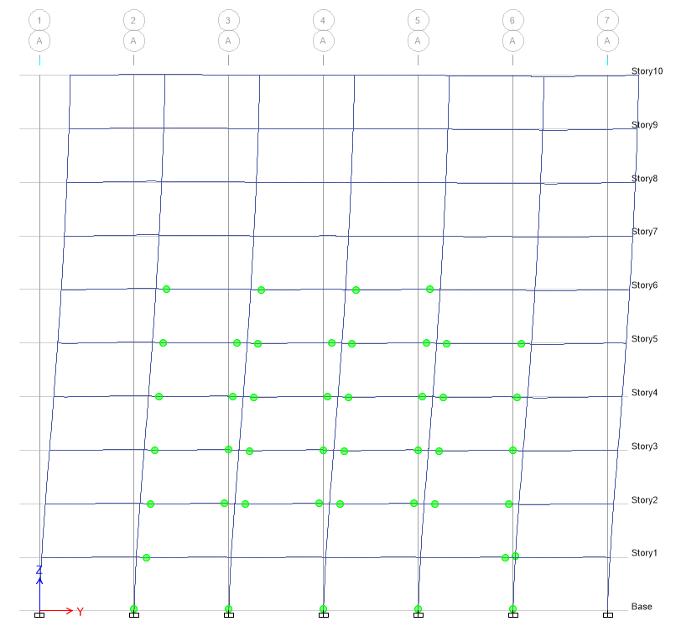


Plastic Hinge Distribution (Y-Dir)
0.5%
1%
Same distribution
as X-dir
1.5%
2%
4%

Slide 38
Nonlinear Time History Analysis
10
“
Maximum Inter-Story Drift
Maximum Floor Acceleration
Floor Shear Distribution

Slide 39




The design-based level of appropriate scaled ground motions.
475 year return period spectrum
X-Dir
original acc.
Y-Dir
original acc.

Slide 40


Maximum Inter-Story Drift
X Direction
Y Direction
MAX
MAX

Slide 41


Maximum Floor Acceleration
MAX
MAX
X-Dir
Y-Dir

Slide 42


Floor Shear Distribution
X-Dir
Y-Dir

Slide 43
Discussion & Suggestion
11
“

Slide 44
Discussion & Suggestion
When the lateral displacement of the top floor reaches 2%, plastic hinges appear at the bottom of the columns on the second floor, which shows that the strength of the columns is insufficient. It is recommended that the cross-section be enlarged to improve its strength.
The stress ratio of the section is smaller than that of other parts, and most of them are shown in light blue on ETABS, which means that our section design this time is conservative and less economical.
To ensure that the inter-story drift doesn’t exceed the limit of 0.00341, the columns and beams are designed with large sections. It is recommended to use a Special Concentrically Braced Frame (SCBF) for a more economical design.

Slide 45

THANKS!

